Slide 1
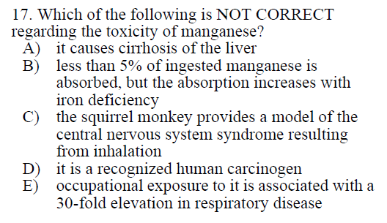

Slide 2
When Mn is combined with bilirubin, it produces intrahepatic colestatis. Liver cirrhosis is a major contributing factor for hepatic encephalopathy.
Fe and Mn can compete for the same binding protein (transferrin) and transporter (DMT1)
Paper from 1969: “Selective depletion of caudate nucleus dopamine and serotonin during chronic manganese dioxide administration to squirrel monkeys”
NO – it is an essential metal for metabolic and cellular functions
Men working in plants with manganese dust show an incidence of respiratory disease 30 times higher than normal.
Answer: D

Slide 3
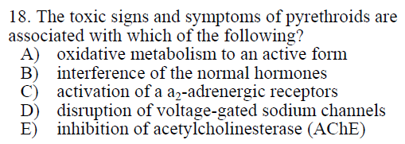

Slide 4
Answer: D

Slide 5
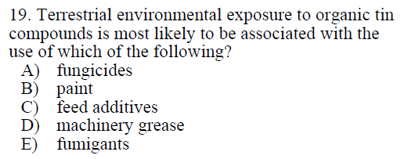

Slide 6
Organotin compounds have been used in fungicides, bactericides, slimicides and plastic stabilizers.
… plasticizers, antifungal agents or pesticides
… biocides
Answer: A

Slide 7
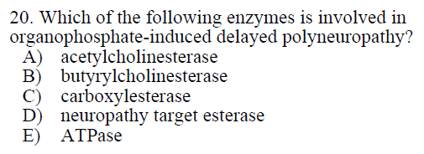

Slide 8
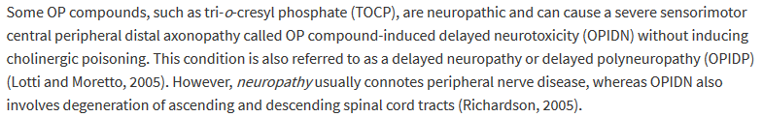
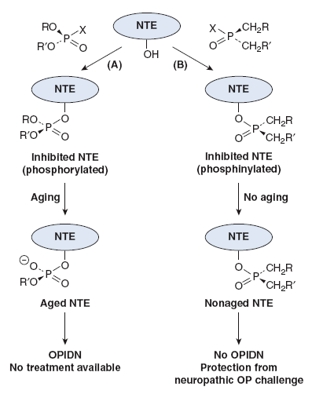
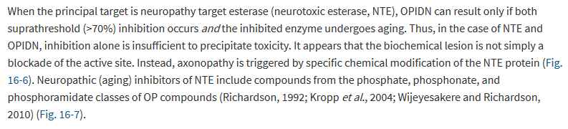
Aging = net loss of a ligand from the phosphorus of the OP-enzyme conjugate
Answer: D

Slide 9
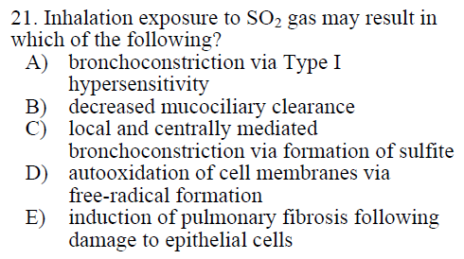

Slide 10
Sulfur dioxide is a water soluble irritant gas, absorbed in the upper airways.
Stimulates bronchoconstriction and mucus secretion.
Dissolves in the surface lining fluid as sulfite or bisulfite. Distributes throughout body and interacts with sensory receptors in the airways to initiate local and centrally mediated bronchoconstriction.
Bronchoconstriction, but due to irritant properties, not allergic reaction (IgE)
Mucus is increased, so mucociliary clearance should go up.
YES – directly from text
Converted to sulfite
Doesn’t usually reach deep lung, if it does, dissolves into sulfite
Answer: C

Slide 11
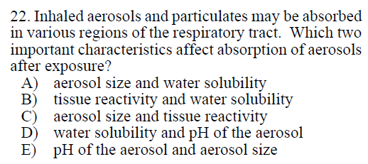

Slide 12
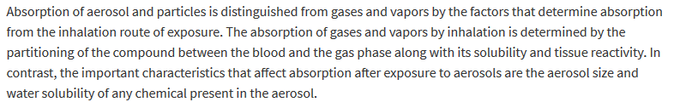
Answer: A

Slide 13
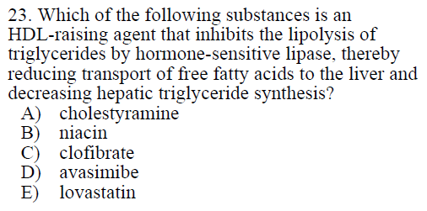

Slide 14
Anion-exchange resin that increases fecal excretion of chlordecone (an organoclornie pesticide)
Increases HDL
Increases lipoprotein lipase activity to promote the conversion of VLDL to LDL
Inhibits ACAT (acyl coenzyme A-cholesterol acyltransferase – catalyze the conversion of cholesterol to cholesterol esters)
Inhibits HMG-CoA reductase to decrease cholesterol biosynthesis
Answer: B ???

Slide 15
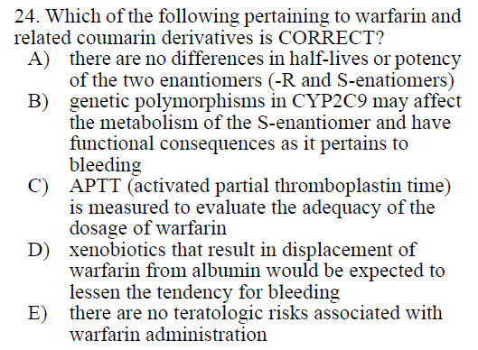

Slide 16
S-warfarin is 3-5 times more potent than the R-enantiomer
YES – CYP2C9 is am important source of variability in response
Measure prothrombin times in comparison to normal pooled plasma (not exactly the same as APTT)
Release of warfarin from albumin INCREASES bioavailability (and would increase tendency for bleeding)
Warfarin is associated with congenital anomalies in 25-30% of exposed infants
Answer: B

